Slide 1

Vicky kumar mahto
Capstone Project:-Sleep Health And Lifestyle
PGA-22

Slide 2
Introduction
Problem Statement: Impact of Lifestyle on Sleep Health
🔘 Problem :Sleep quality is one of the main products of a healthy lifestyle. We spend about a third of our lives sleeping — or at least we should. All kinds of food that sparkles in food.Unfortunately, many of us fall short of that goal. According to the National Institutes of Health, insomnia affects about one-third of the general population, making it the most common sleep disorder in the United States. Here's what you need to know about sleep..
🔘 Solving the problem : With the development we are witnessing from artificial intelligence, machine learning models can be used and then trained on a set of training data, then tested on a set of test data, and the classifier predicts whether a person has sleep disorder or not based on the data to be entered..!

Slide 3
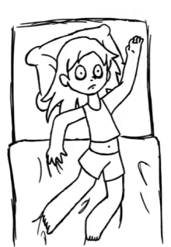
I can't sleep!!!

Slide 4
Data features 🌐
Person ID: An identifier for each individual.
Gender: The gender of the person (Male/Female).
Age: The age of the person in years.
Occupation: The occupation or profession of the person.
Sleep Duration (hours): The number of hours the person sleeps per day.
Quality of Sleep (scale: 1-10): A subjective rating of the quality of sleep, ranging from 1 to 10.
Physical Activity Level (minutes/day): The number of minutes the person engages in physical activity daily.
Stress Level (scale: 1-10): A subjective rating of the stress level experienced by the person, ranging from 1 to 10.
BMI Category: The BMI category of the person (e.g., Underweight, Normal, Overweight).
Blood Pressure (systolic/diastolic): The blood pressure measurement of the person, indicated as systolic pressure over diastolic pressure.
Heart Rate (bpm): The resting heart rate of the person in beats per minute.
Daily Steps: The number of steps the person takes per day.
Sleep Disorder: The presence or absence of a sleep disorder in the person (None, Insomnia, Sleep Apnea).

Slide 5
Table of Contents 🏢
1.The purpose of the project 🔐
  A simple definition of the idea of ​​the project
2.Data features 🌐
  Definition of features of data
3.Importing libraries ⏳
  Recall the most important libraries which we needed
4.Reading data 📖
  This is an important step to know dataset quickly and start organizing ideas
5.Statistical information 🔍
  Data shape
  Detect empty and type of values
  Statistical understanding of the data

Slide 6
6.Exploratory Data Analysis (EDA)📊
  knowing the column names
  Knowledge of information through data and its representation in graphs
  Know the parts that are not clear in the data in its normal form
7.Data preprocessing 🛠️
  Finding and cleaning null values
  Data encoding
  Data correlations
  Data splitting
8. Data modeling ⚙️
  Build many models
  Logistic regression
  Decision Tree
  Random Forest
  Adaboost
  XG boosting
  Gradient boosting
  9. Models evaluation 📝
  Using confusion matrix
  10 HYPERPARAMETER TUNNING

Slide 7
Statistical information
🔘 A visual and mathematical portrayal of information is statistics.
🔘 Data science is all about making calculations with data.
🔘 We make decisions based on that data using mathematical conditions known.

Slide 8
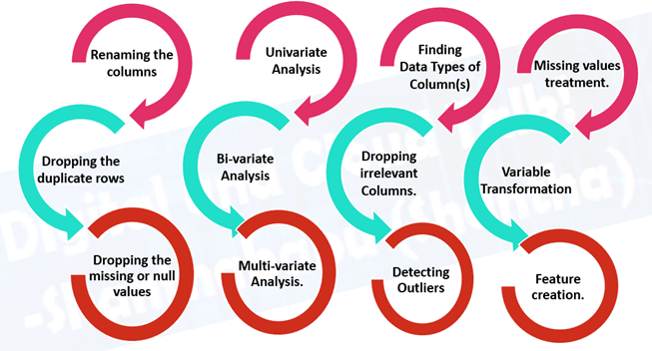
Exploratory Data Analysis (EDA) 📊
Understanding the given dataset and helps clean up the given dataset.
It gives you a clear picture of the features and the relationships between them.
Providing guidelines for essential variables and leaving behind/removing non-essential variables.
Handling Missing values or human error.
Identifying outliers.
EDA process would be maximizing insights of a dataset.

Slide 9
Perform grid search for hyperparameter tuning
GridSearchCV DecisionTreeClassifier
GridSearchCV(RandomForestClassifier

Slide 10
Data preprocessing
🔘 Data preprocessing refers to the technique of preparing (cleaning and organizing) the raw data to make it suitable for a building and training Machine Learning models.

Slide 11
Data Spliting
Data modeling ⚙️
LogisticRegression Model
Decision Tree
Random Forest
Svm
XGBClassifier Model
GradientBoostingClassifier Model
Adaboost

Slide 12
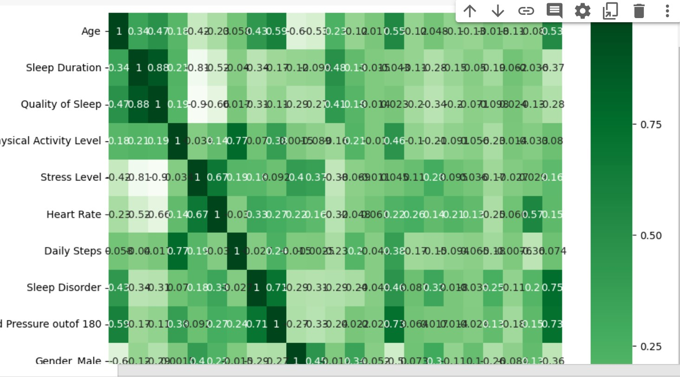
Heatmap Correlation- To check relation with Target Variable

Slide 13
Conclusion
Details about Sleep Disorder Column:
None: The individual does not exhibit any specific sleep disorder.
Insomnia: The individual experiences difficulty falling asleep or staying asleep, leading to inadequate or poor-quality sleep.
Sleep Apnea: The individual suffers from pauses in breathing during sleep, resulting in disrupted sleep patterns and potential health risks.

